Slide 1




R PROGRAMMING
ESE-3
DATA ANALYSIS IN R PROGRAMMING
PRESENTED BY
AVICHAL TRIVEDI

Slide 2
INTRODUCTION
Objective:
To explore and analyze Netflix's content catalog to discover patterns in content type, genres, release trends, and regional distribution.
Dataset Overview:
Name: Netflix Movies and TV Shows Dataset
Source: Kaggle
Total Records: ~8,800+ titles
Key Attributes: Type, Title, Country, Release Year, Rating, Duration, Genre
Key Questions Addressed:
What’s the distribution between Movies and TV Shows?
Which genres and countries dominate?
How has Netflix’s content evolved over time?
What are typical durations for movies?

Slide 3
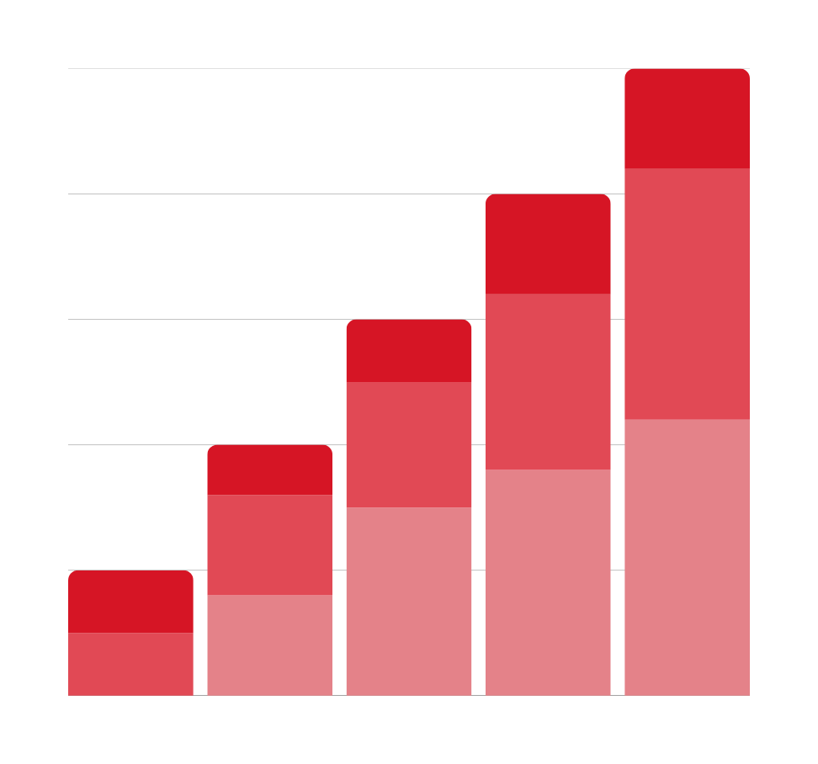
TOOLS AND TECHNOLOGIES
TECHNOLOGIES AND LANGUAGES
R Programming
RStudio (IDE)
CSV File Handling
KEY R - PACKAGES
dplyr – Data manipulation (filtering, summarizing, grouping)
ggplot2 – Data visualization (bar charts, histograms, line plots)
readr – Reading CSV files efficiently
tidyr – Text data cleaning (splitting multi-genre rows)
TECHNIQUES APPLIED
Data Cleaning & Preprocessing
Content Trend Analysis (year-wise)
Genre & Country Frequency Analysis
Duration Distribution
Custom R Functions for Statistical Insights

Slide 4
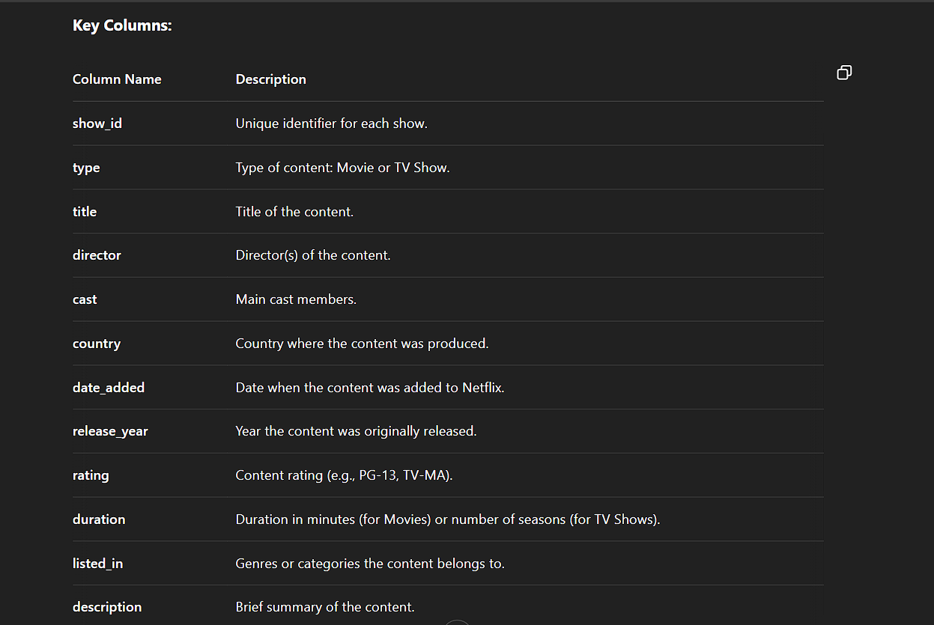
DATASET EXPLANATION
Overview:
This dataset contains detailed information about the movies and TV shows available on Netflix. It is used to analyze trends, content distribution, and other key insights related to Netflix’s offerings.
The key columns of the dataset is provided on the right as a table.
Usage:
Content Analysis: Understanding the distribution of movies vs TV shows, identifying top genres, and tracking content over time.
Geographic Insights: Analyzing the country of origin for Netflix’s content.
Viewer Trends: Investigating content ratings, release trends, and genre popularity.

Slide 5

PROBLEM
STATEMENT
With the rapid expansion of digital streaming platforms, understanding content trends, viewer preferences, and content diversity has become crucial for providers like Netflix. This project aims to analyze the Netflix Movies and TV Shows dataset to uncover patterns in content type distribution, release trends over the years, most popular genres, and top content-producing countries. The goal is to gain actionable insights into how Netflix's content has evolved and to identify factors that influence its content strategy.

Slide 6
📥
🔍
🧠
🧹
📊
STEPS
🧮
Data Loading:
Imported Netflix dataset using read_csv() for initial inspection
Data Cleaning:
Removed rows with missing values in critical columns (e.g., type, release_year, duration).
Used filter() and mutate() for preprocessing.
Exploratory Data Analysis (EDA):
Content Type Distribution: Movies vs. TV Shows
Release Year Trend: Titles added over time
Top 10 Genres: Extracted using separate_rows() and grouped
Top Producing Countries: Most frequent content origins
Duration Analysis: Histogram of movie lengths
s
Visualization:
Created meaningful plots using ggplot2 including:
Bar Charts
Line Plots
Histograms
Insights & Interpretation:
Interpreted findings to understand Netflix’s content trends and strategy.
User-Defined Function:
Calculated average number of releases per year using a custom R function.

Slide 7
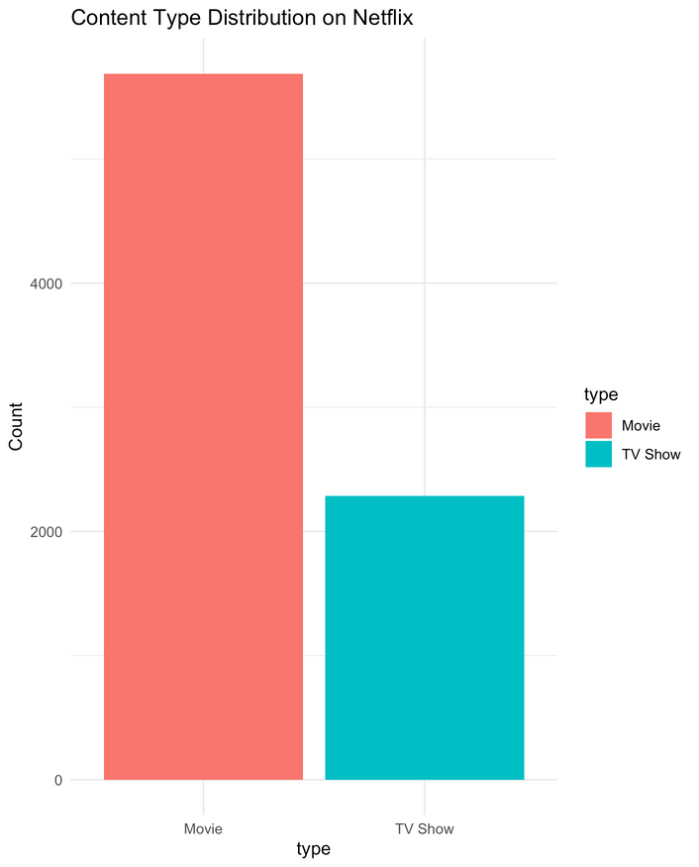
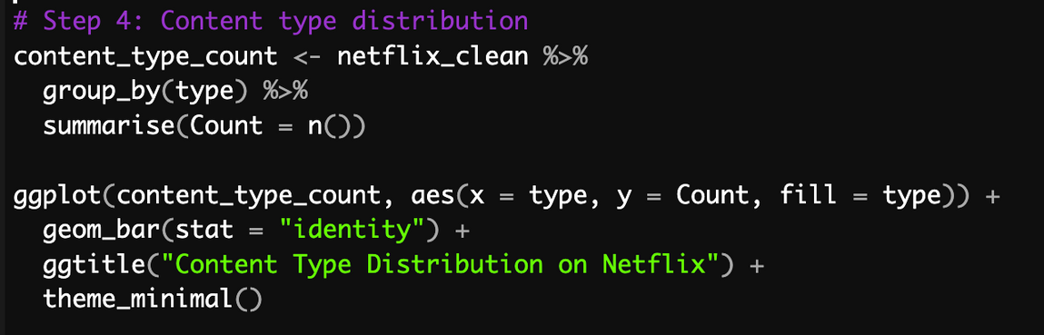
QUESTION
WHAT IS THE CONTENT TYPE DISTRIBUTION ON NETFLIX ?
PLOT
CODE SNIPPET

Slide 8
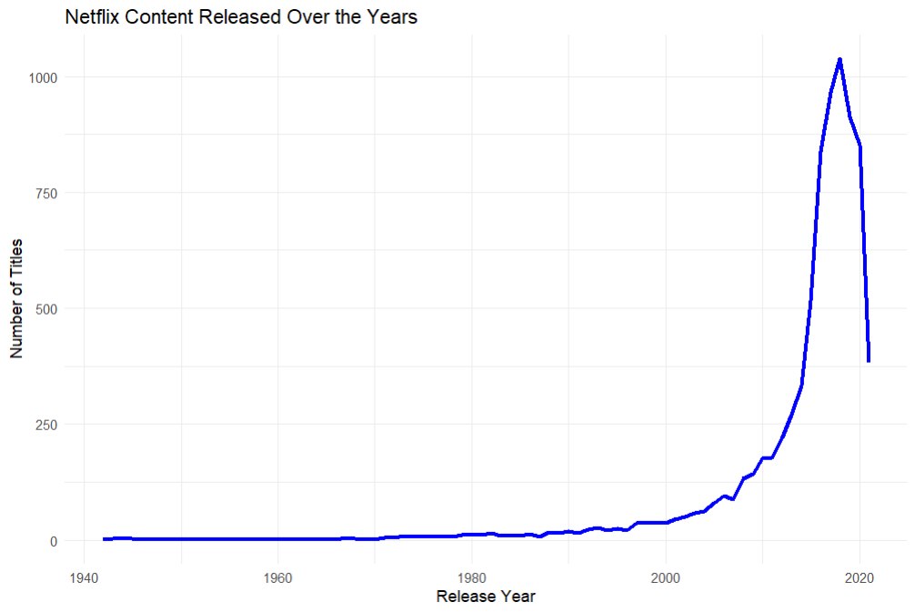
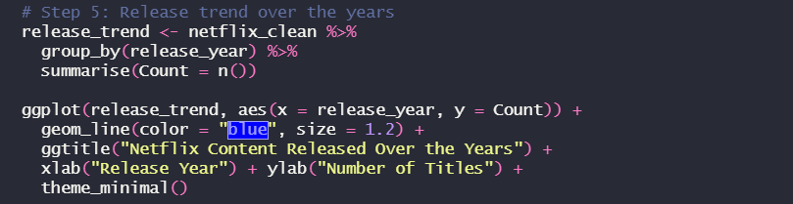
QUESTION
WHAT ARE THE NETFLEX RELEASE TRENDS OVER YEARS
CODE SNIPPET
PLOT

Slide 9
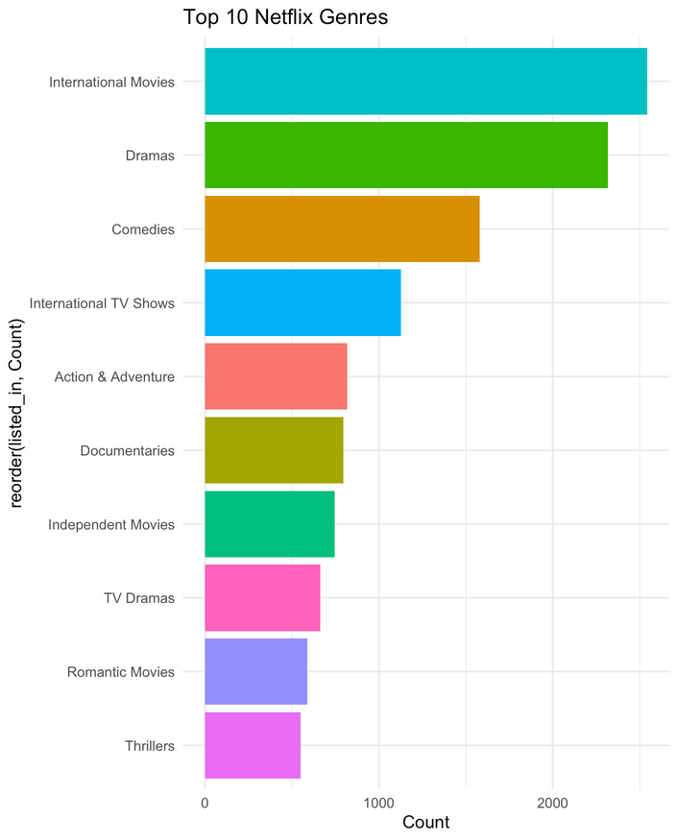
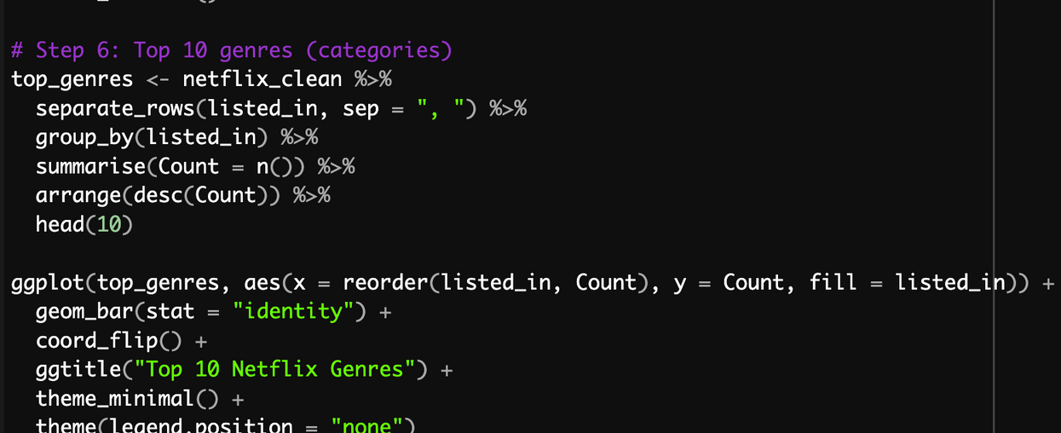
QUESTION
WHAT ARE THE TOP 10 GENRES
PLOT
CODE SNIPPET

Slide 10
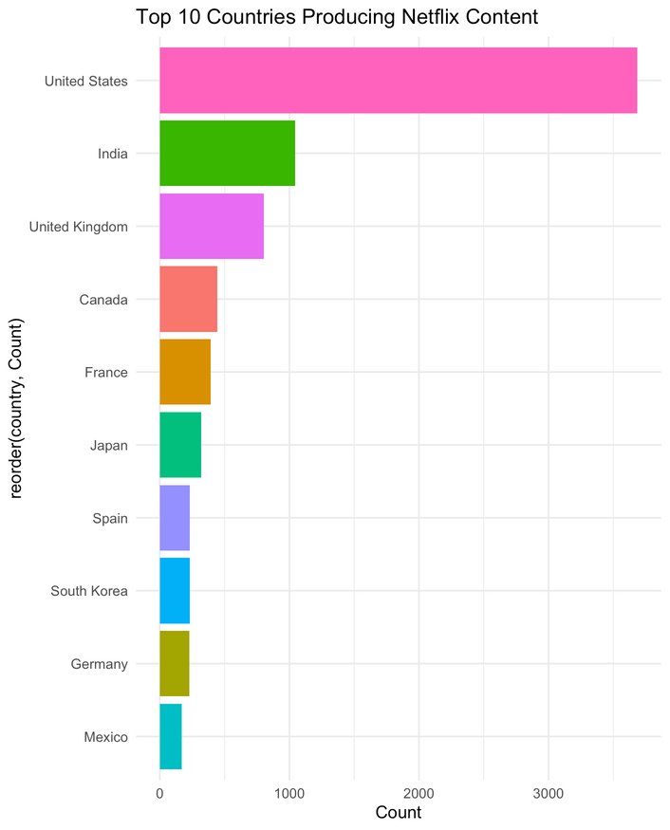
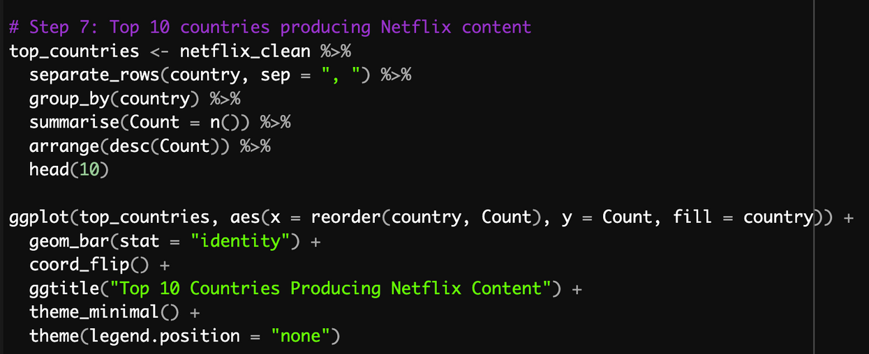
QUESTION
WHAT ARE THE TOP 10 COUNTRIES PRODUCING NETFLIX CONTENT
PLOT
CODE SNIPPET

Slide 11

CONCLUSION
This project provides an in-depth exploration of Netflix's content over the years, identifying key trends and popular genres, while utilizing R programming for effective data analysis and visualization. The findings can serve as a reference for Netflix's content strategy and future content recommendations.

Slide 12
:)
THANK YOU

